Slide 1


Shree Seva Foundation

Slide 2
“Shree Seva Foundation” is an NGO in India based in Mumbai (Maharashtra). Established in 2019, we have worked extensively for more than 4 years to reach out and empower people from the underprivileged segment. Shree Seva Foundation works with 3 branches in India while focusing on providing proper Physical, Social, and Economic empowerment in the field of Yuva, Nari & Health. We do this through well-planned and comprehensive programs in health, education, training, rehabilitation, health camps, and helping aid distribution making us the best Seva organization in India.
We are an organization that helps the individuals realize their hopes, dreams, and ambitions and help those who need just a little extra support. So far, Shree Seva Foundation and its tireless team with the noble reverences have organized over 500 Health Check up / Blood check up Camps & helped individuals free of cost corrective treatment and we don't intend to stop. Apart from free of cost treatment & hospitalization, we also provide free of cost training to Nari Shakti & Yuva and vocational training programs in employable skills for Nari Shakti & Yuva Our other initiatives focus upon the social rehabilitation of people in need.
Our aim is to create an inclusive society, where Nari Shakti & Yuva Shakti are accepted into the mainstream economy and social life. We believe that every single person is special and talented and is just looking for a chance to excel.

Slide 3
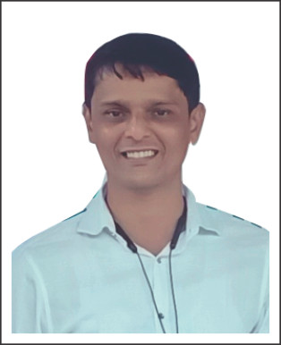
Mr. Pramod Dhondiram Kate
(GDCA, BSW)
President –
Shree Seva Foundation
Corona Yoddha Karmchari Parishad
Udyog Nirman Seva Sangh
Bharatmata Seva Pratishthan
Sahkar Bharti – EX Sanghtan Pramukh (Kokan Region)

Slide 4




- OUR PROJECTS -
Aarogya Seva
Yuva Aadhar
Nari Shakti

Slide 5

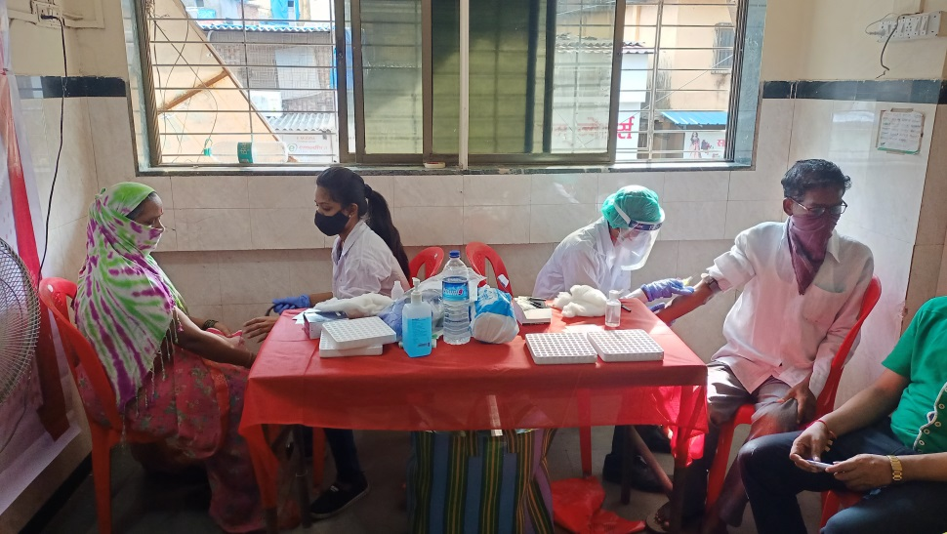
Aarogya Seva
Health is Wealth
Recent years have been tough for everyone. Covid-19 Pandemic taught us how important it is to keep care of our health. People are becoming more conscious about their physical and mental health and working towards it for a better living. There are various sections of society who are still deprived of basic health facilities because of their financial problems and lack of awareness about government aid. Shree Seva Foundation have worked remotely in various regions of Maharashtra by running Clinics in rural areas, organizing Health Checkup Camps, Blood Donation Camps and many other initiatives.
We believe everyone have a fundamental right for a healthy living and no one should be deprived of health facilities irrespective of their caste, creed, religion or economic background. Come Join Us with a motivation to work for the poor and needy.

Slide 6
We take various initiatives such as –
HEALTH CHECKUPS
We Conduct Health Checkups & Consultancies on various ailments
for FREE.
Blood Test Camps where we conduct various tests of Rs 1,000 to Rs 1,500 at nominal just Rs 20/- only.
HEALTH CARE
Dispensary at Rs 20
FREE expert Doctor consultancy
Three times medicine dose at just Rs 20 only.
Various Blood Tests at a very Reasonable Rate.
Injections at Rs 90 only.
Ivy at Rs 90 only.

Slide 7
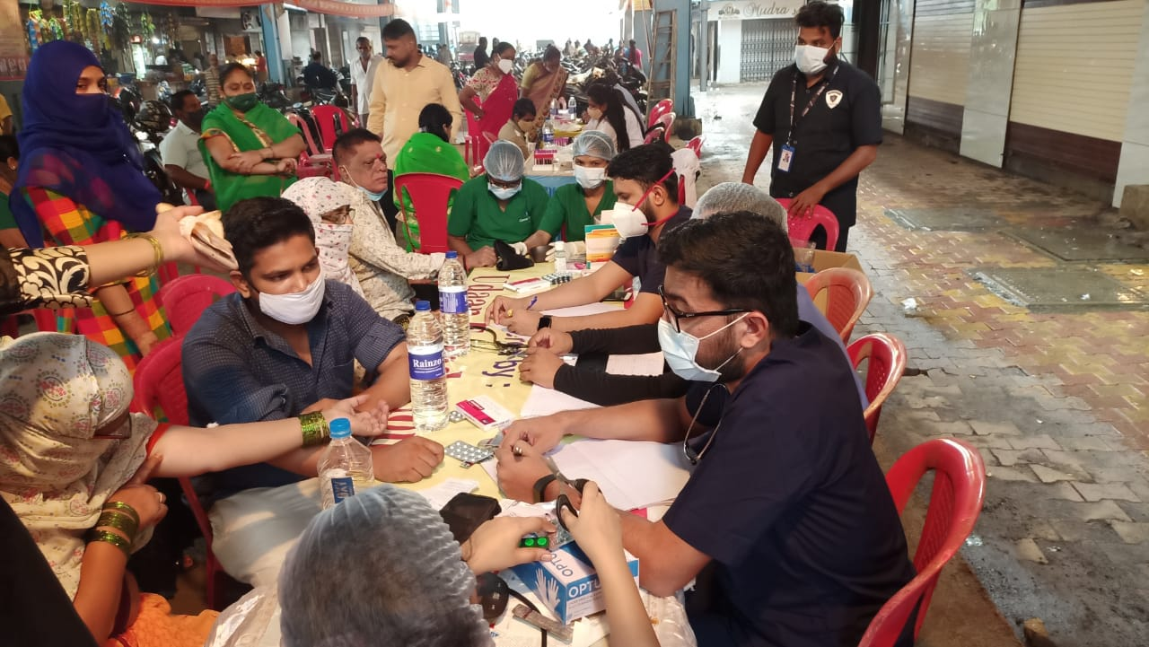
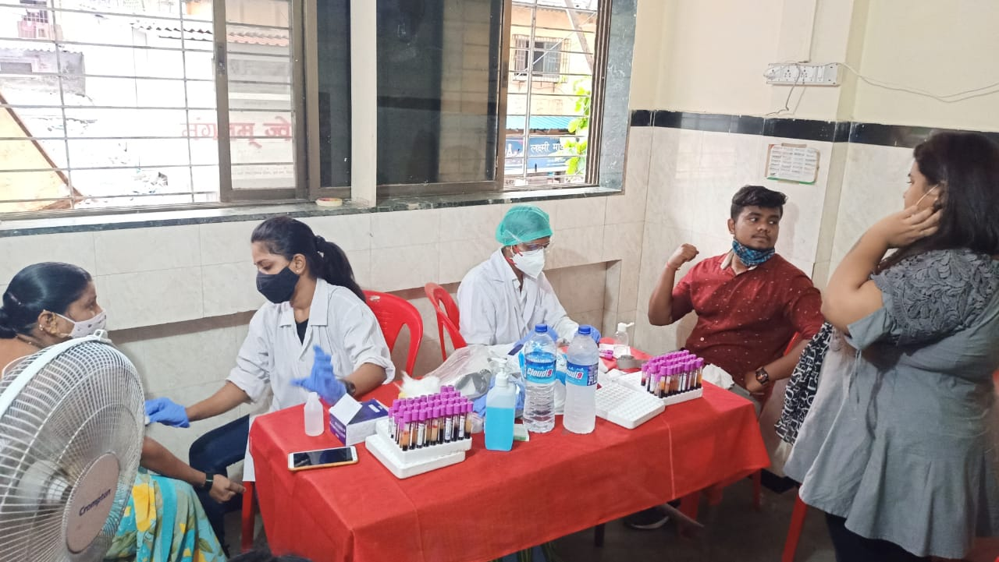
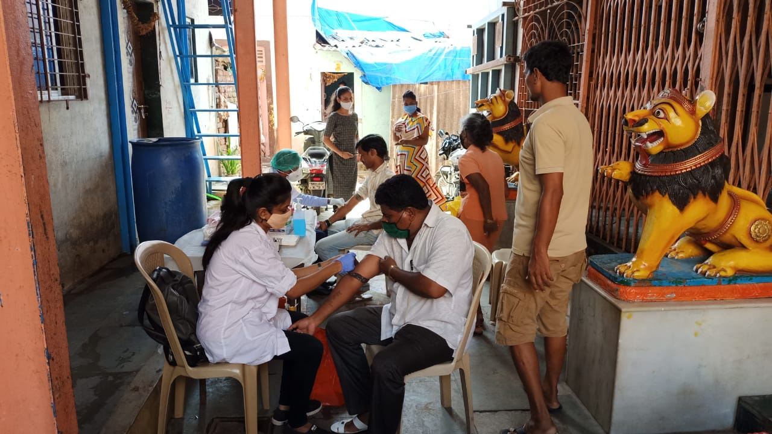
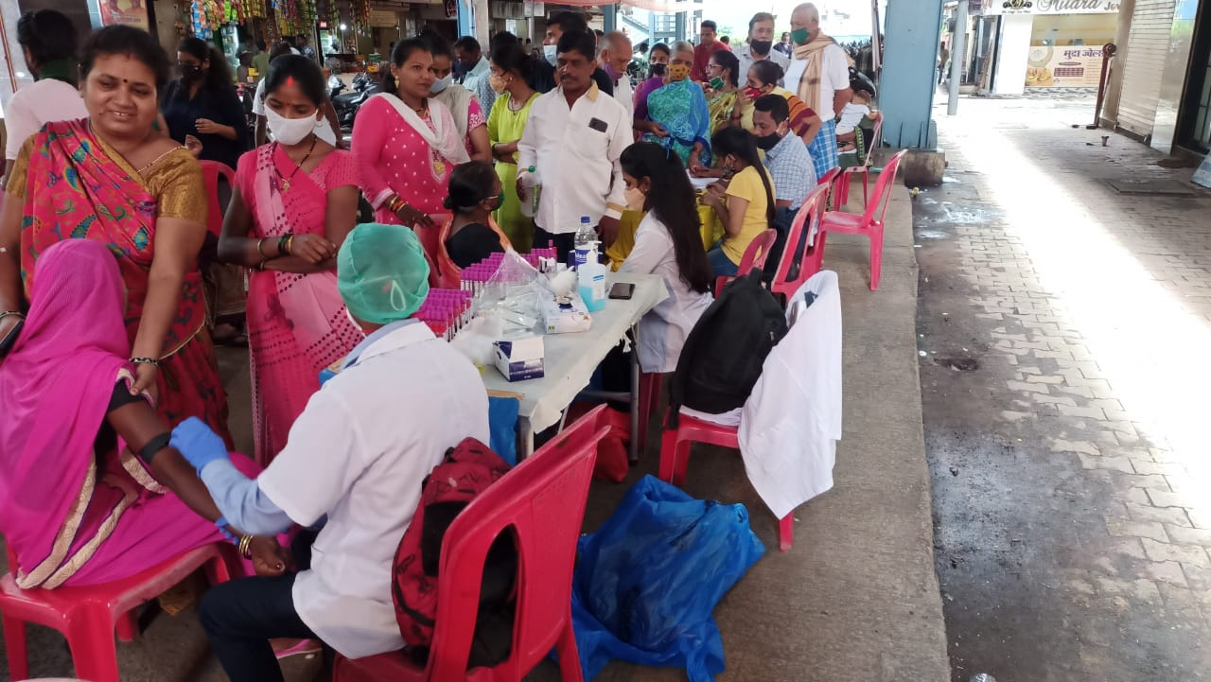
Health Check-up Camps

Slide 8
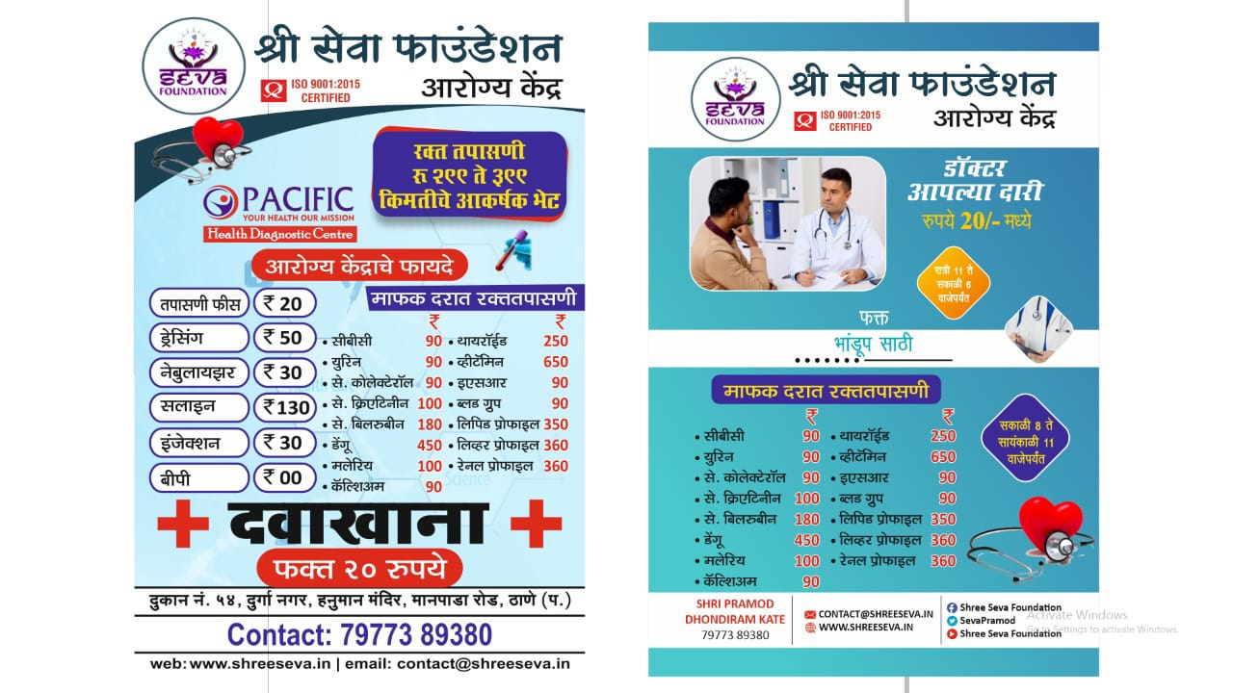

Slide 9
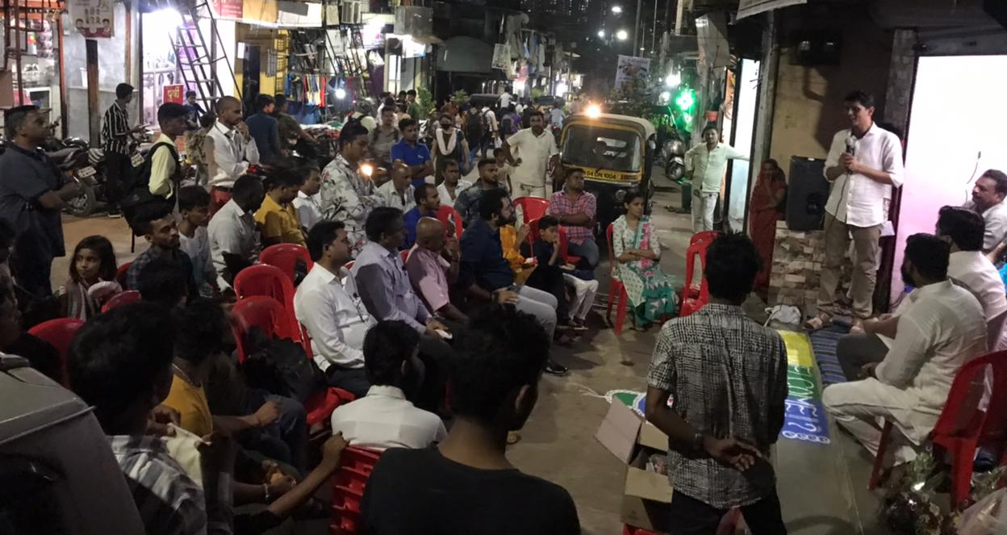
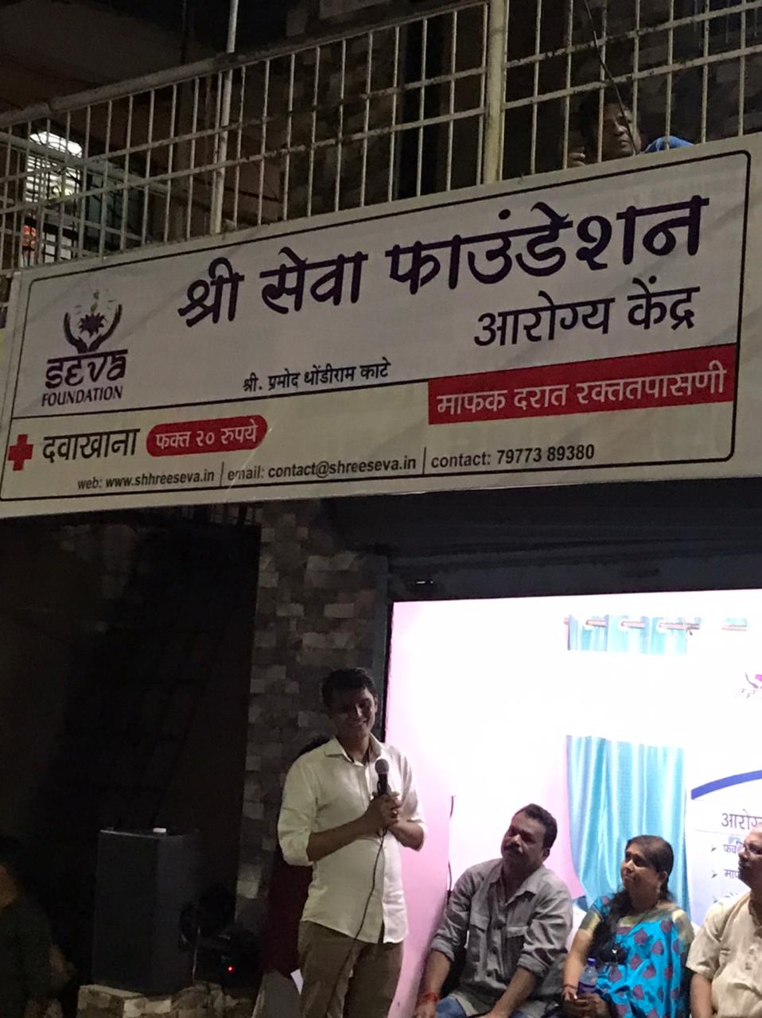
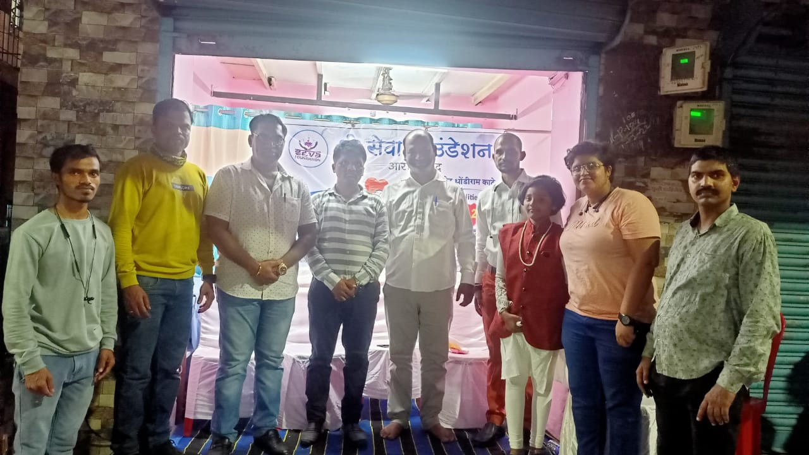
Shree Seva Medical Centre
Dispensary at
Rs. 20/- only

Slide 10
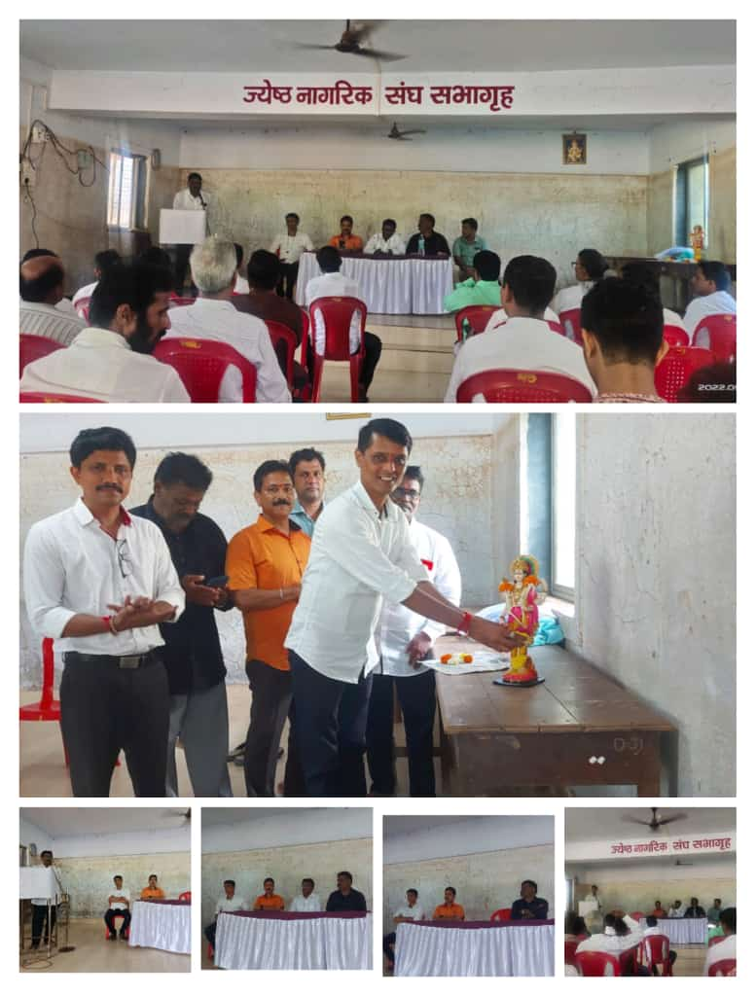
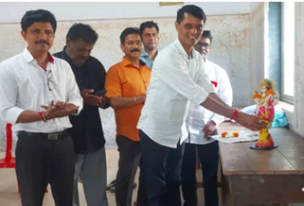
Medical Health Guidance Seminar
Mahad Poladpur

Slide 11
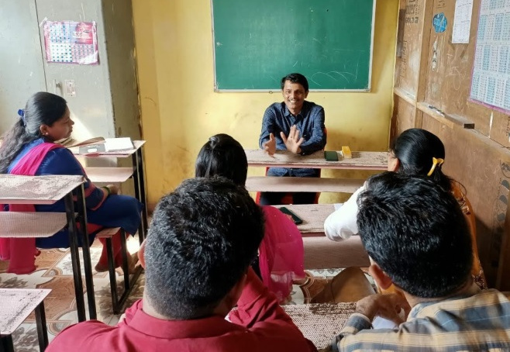
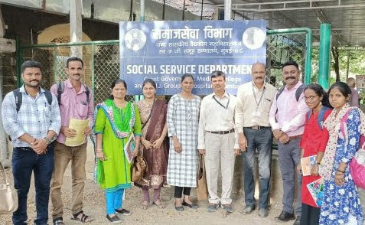
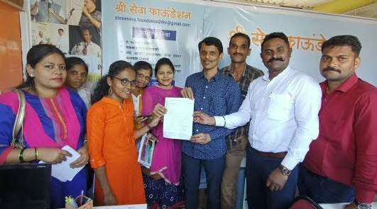
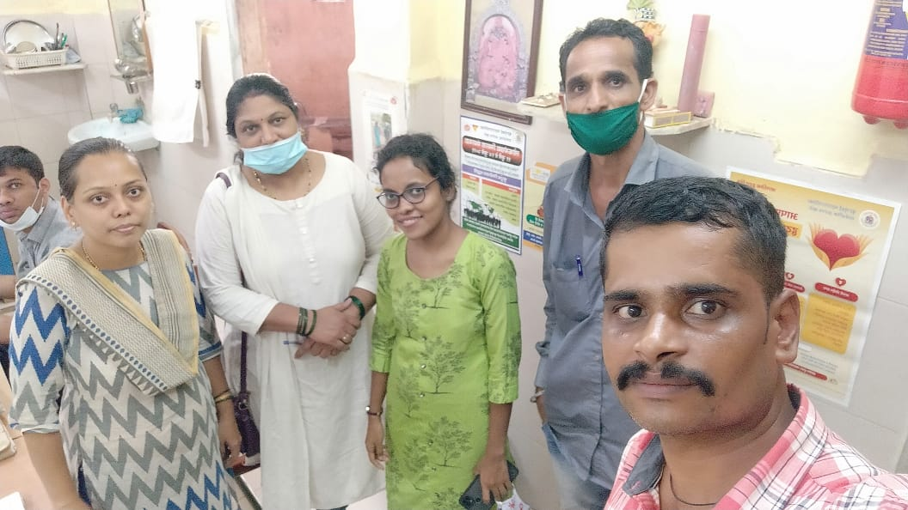
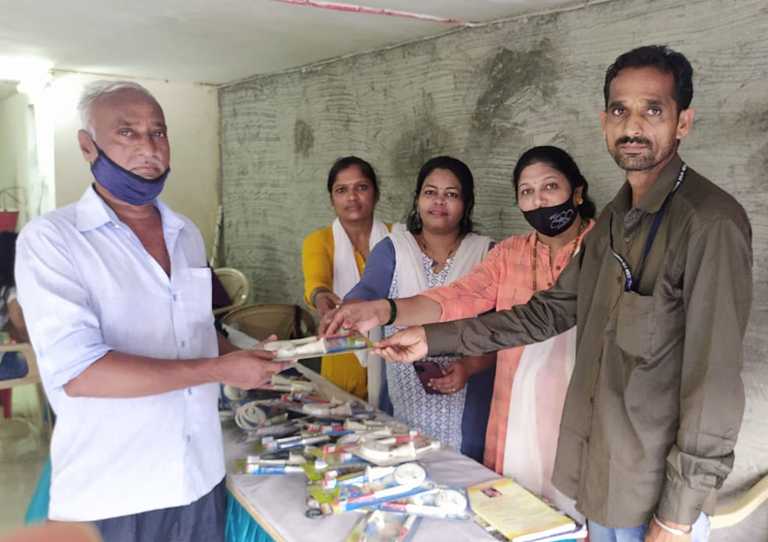
MSW students (IGNOU)
with Shree Seva Foundation
(45 days activity)

Slide 12
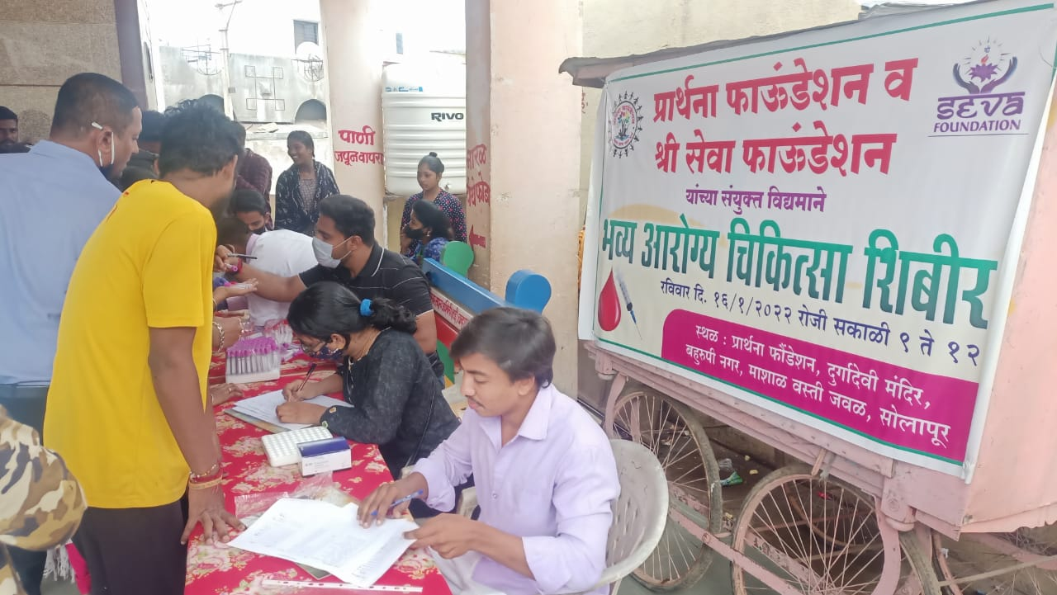
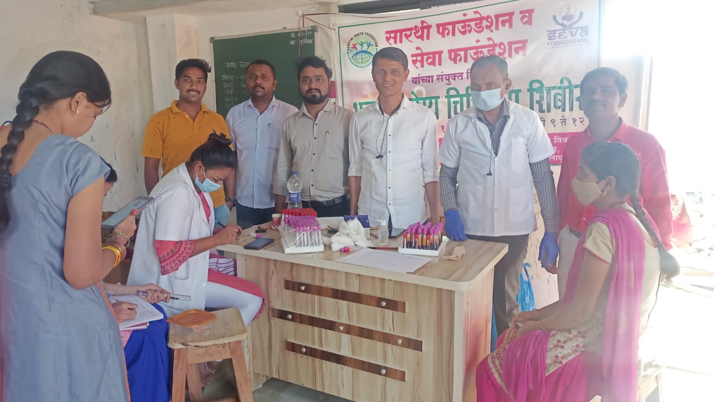
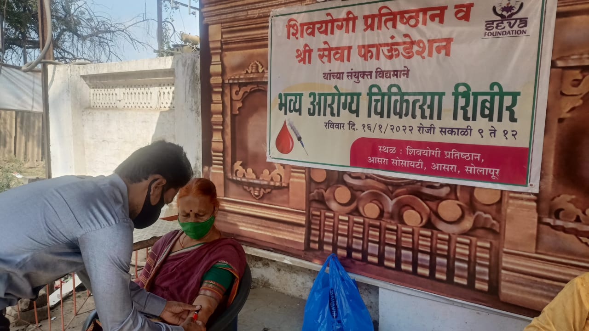
Medical Health Check-up at- Solapur

Slide 13
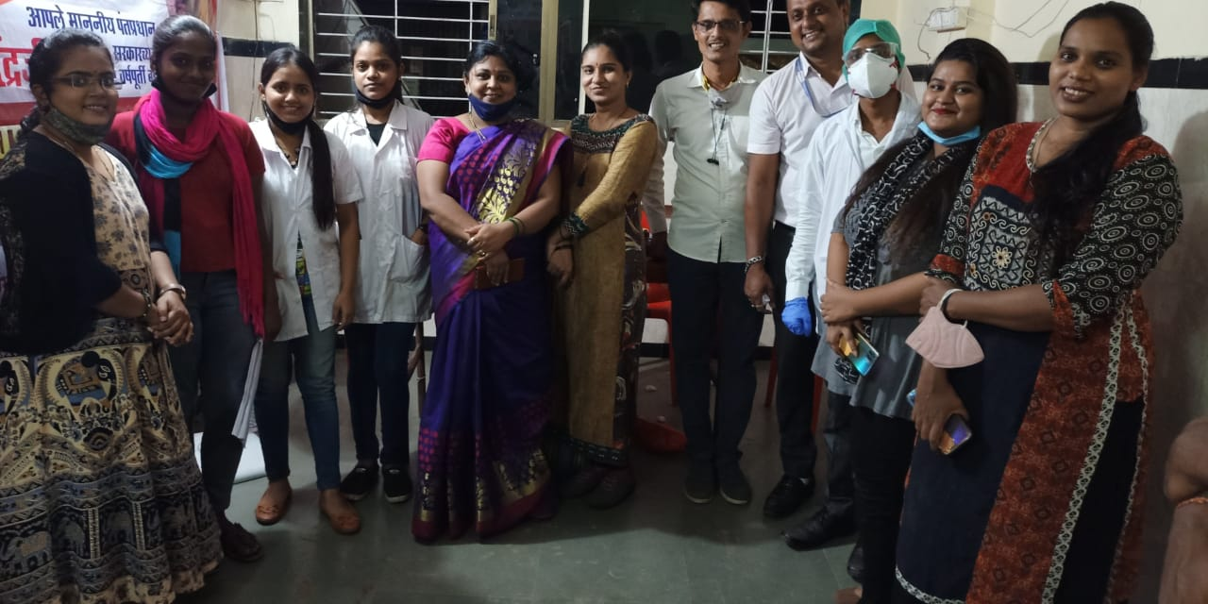
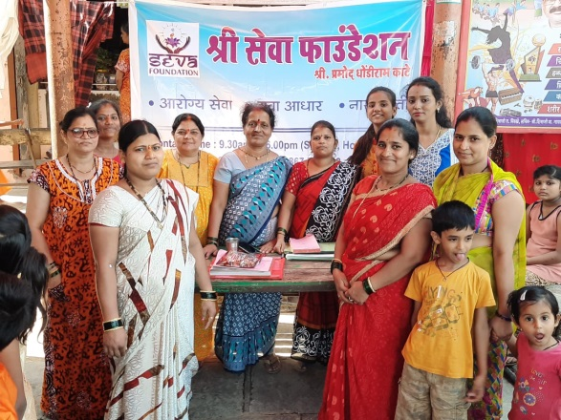
Naari Shakti
Our Naari Shakti is equally working with Men
towards the development of this country.
We believe in women empowerment &
we not just believe, we work for it.
Our Objectives :
To make women aware of their rights and capabilities.
To create awareness about the schemes launched by the
Government for empowering women.
To enable Naari Shakti to be instrumental in the development of the country.
Our Key Focus Areas :
Sexual Health Financial Literacy
Quality Education Mental Health Awareness
Exhibitions of Women Entrepreneurs

Slide 14
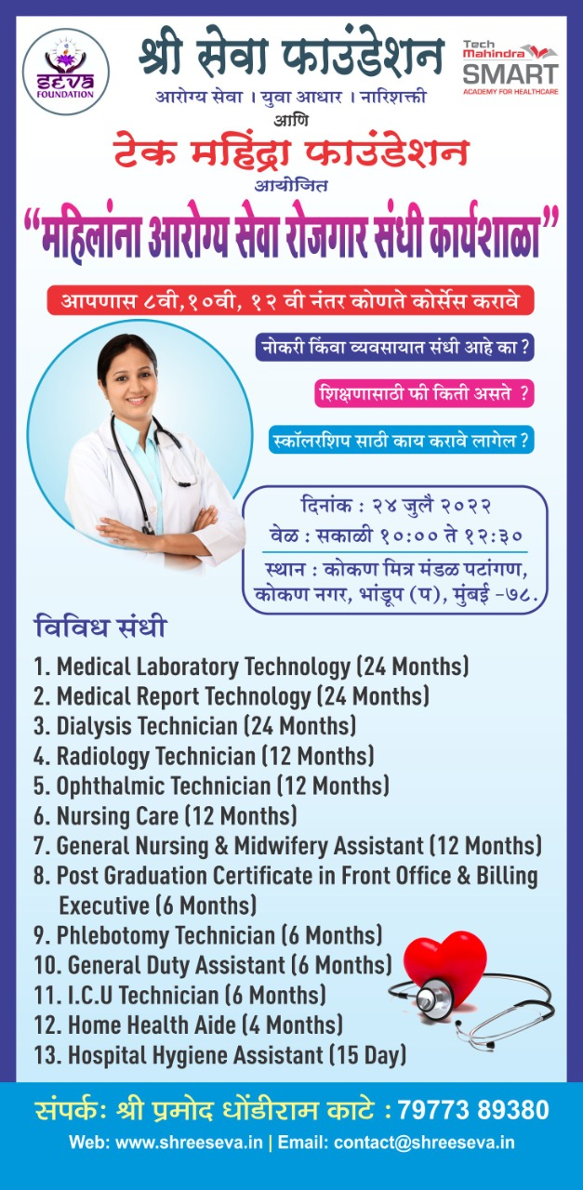
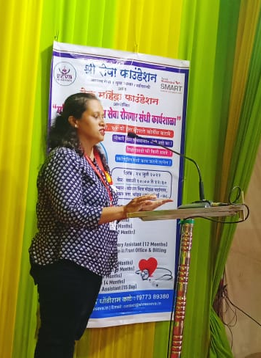
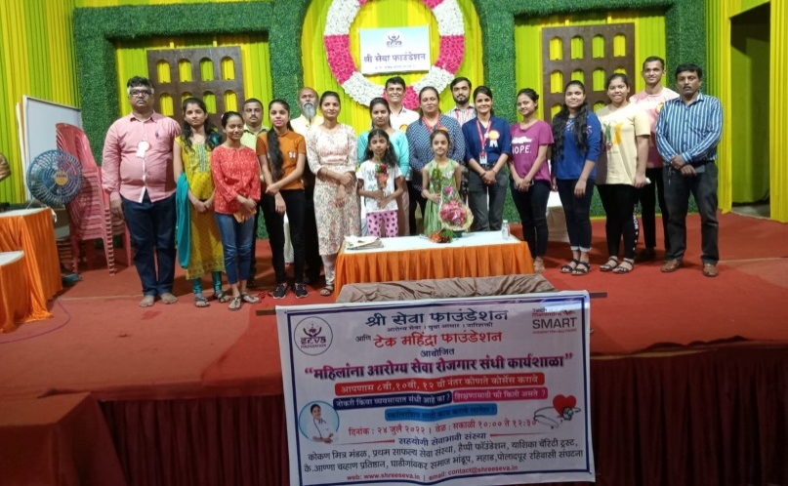
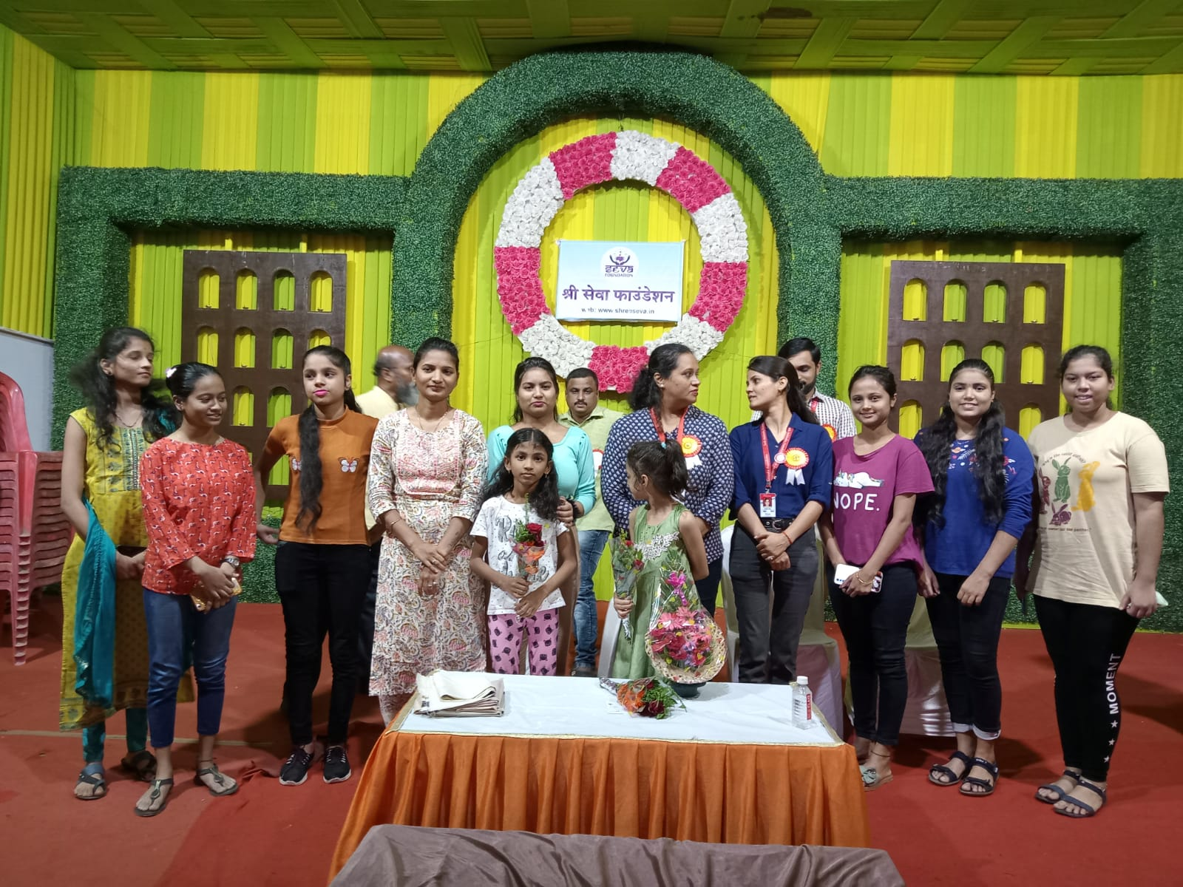
Scholarship to Students

Slide 15

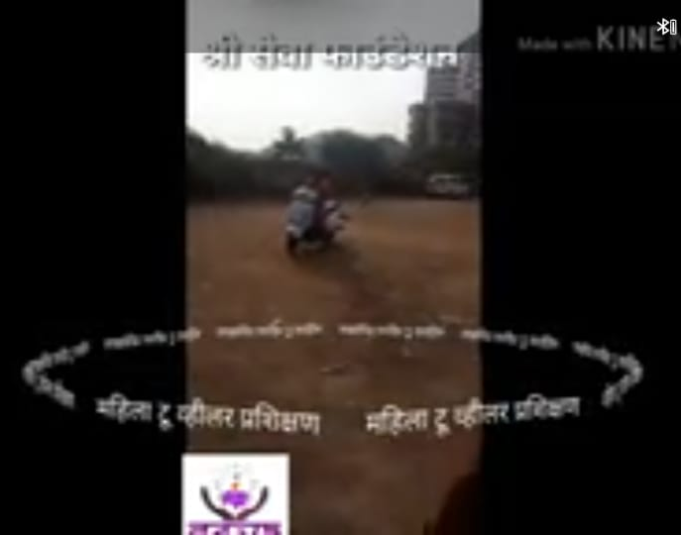
FREE FREE FREE
2Wheeler Trainings to Ladies

Slide 16
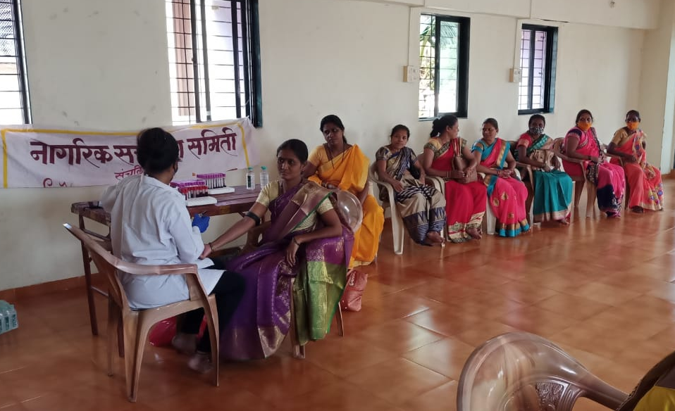
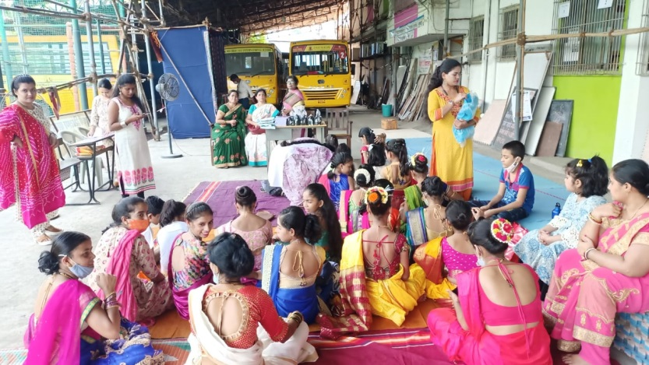
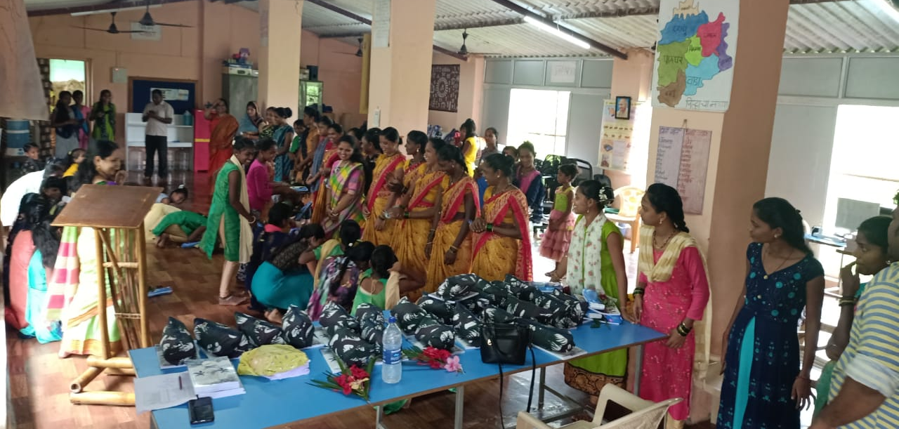
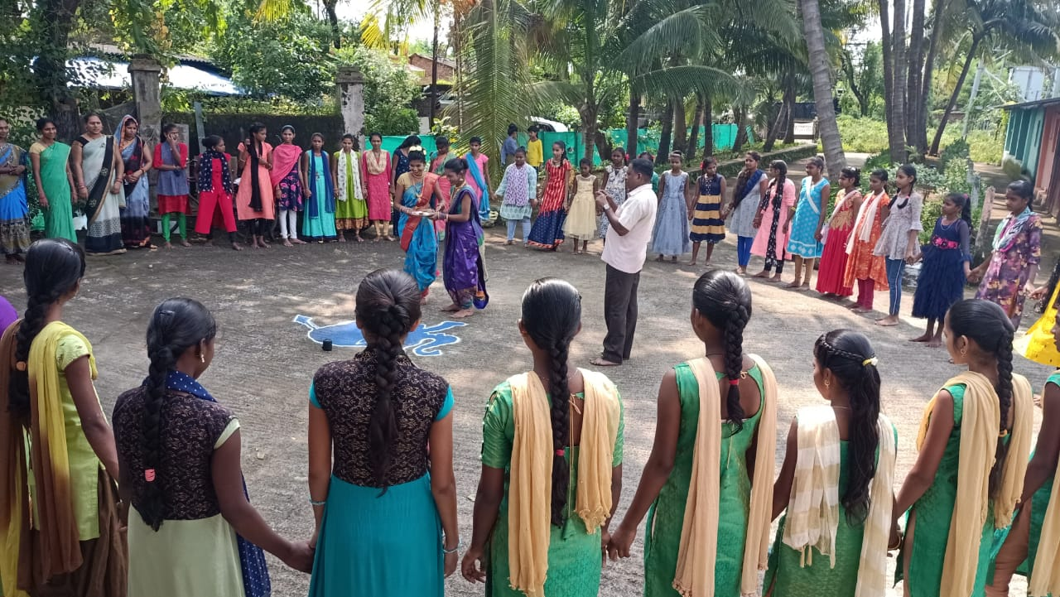
Medical Health Check-up at- Palghar, Wada, Dahanu (Maharashtra Tribal area)

Slide 17
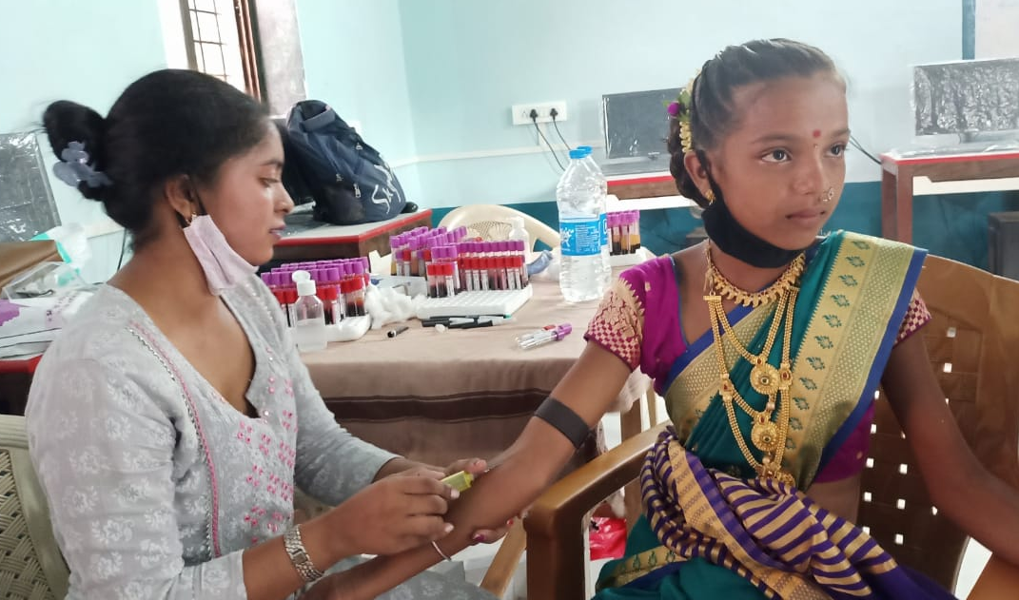

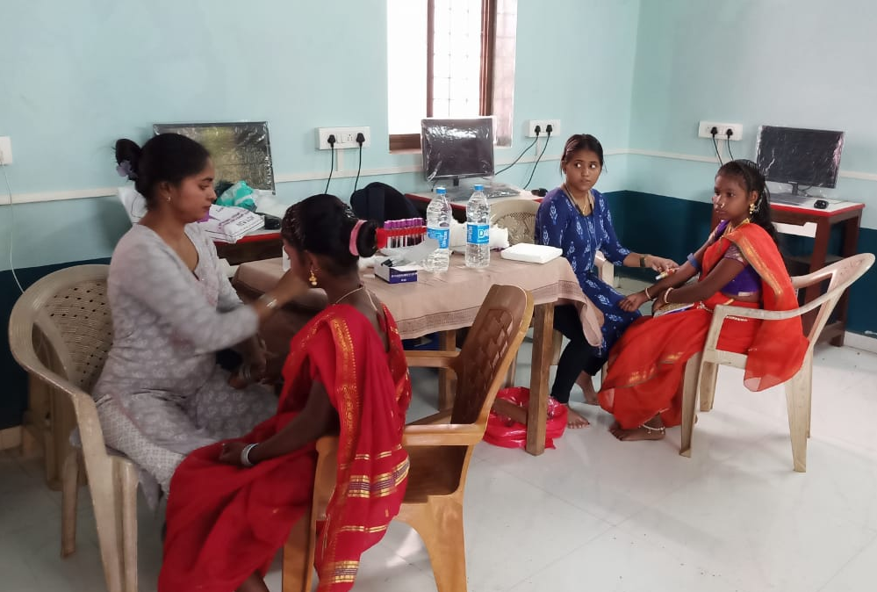
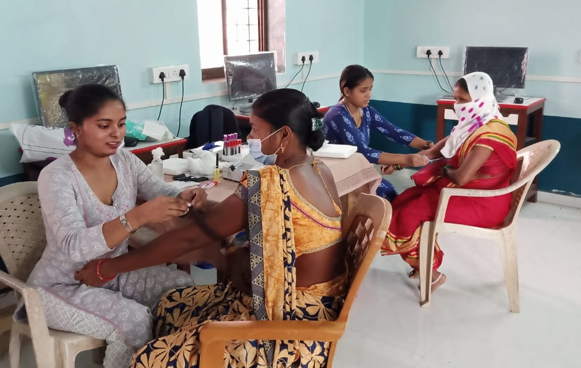
Medical Health Check-up
at- Maharashtra Tribal area

Slide 18
Yuva Aadhar
India is a country of youth. Yuvashakti is the real wealth of the country. “Shree Seva Foundation” Aim towards empowering youth power of the nation in a right direction to make them economically strong and able. We want to create an ecosystem of young entrepreneurs who can serve for the betterment of this country. We organize a couple of events, workshops and seminars to guide youngsters towards the path of success.

Slide 19
Yuva Aadhar
Our Key Programs
Entrepreneurship Workshops
Seminars (Online/ Offline)
Career Guidance
Job Openings/Alerts
Industry Exhibitions
YouTube Channel (Live or Recording)

Slide 20

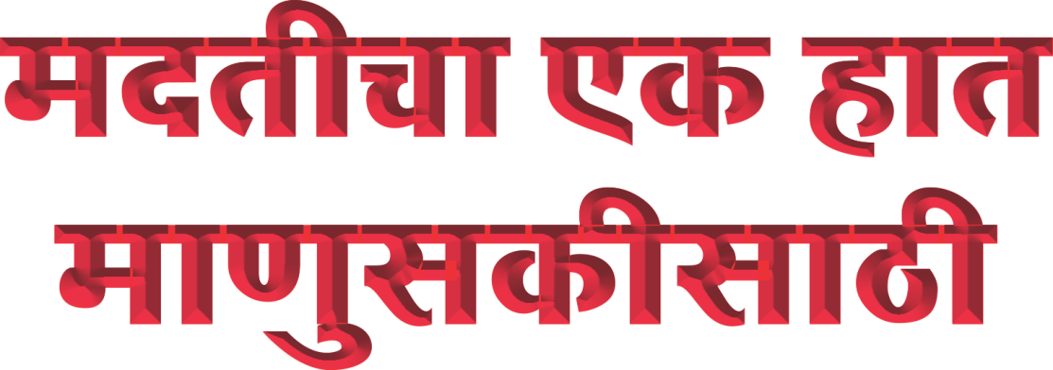

Slide 21
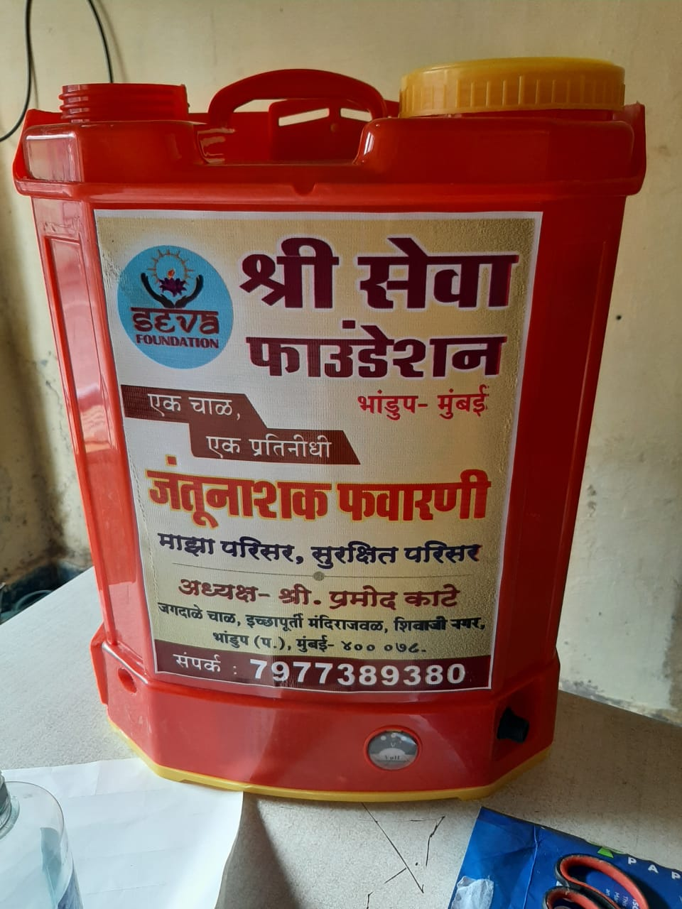

FREE Sanitization in Local Area during Covid-19

Slide 22
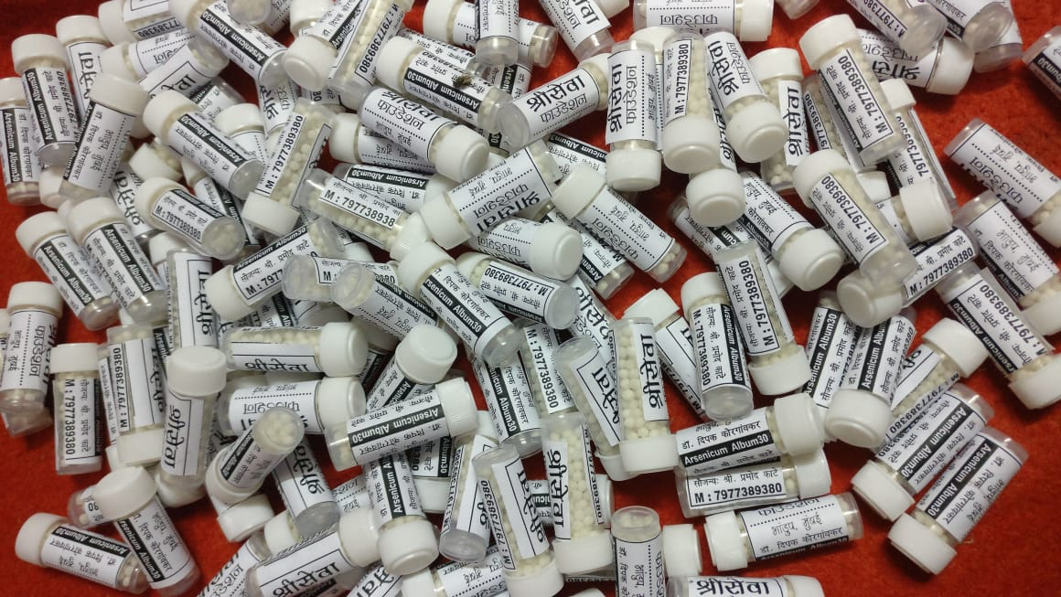
FREE DISTRIBUTION
Arsenic Album

Slide 23
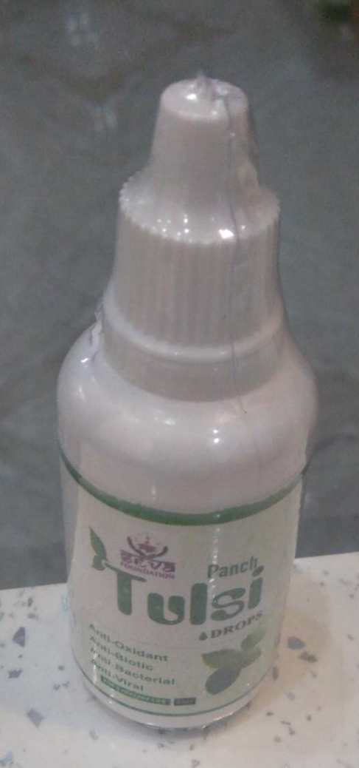
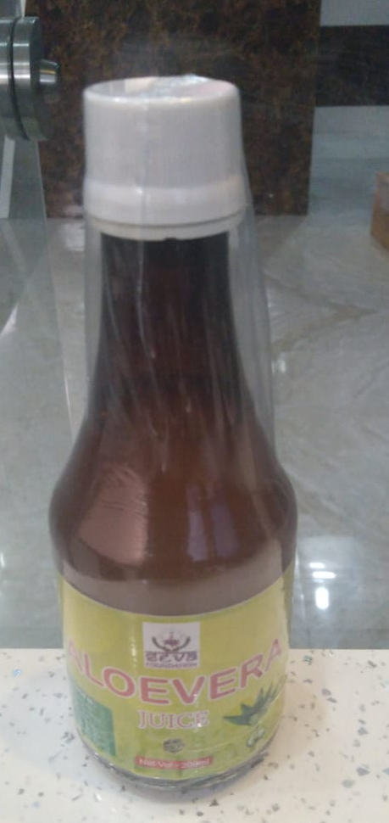
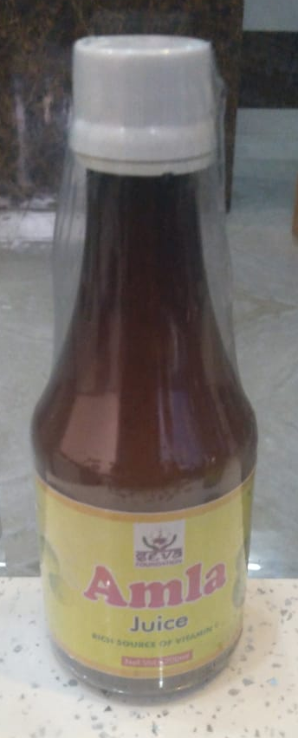
Shree Seva Foundation Distributes
Tulsi Drops and Olevera, Amla Juice

Slide 24
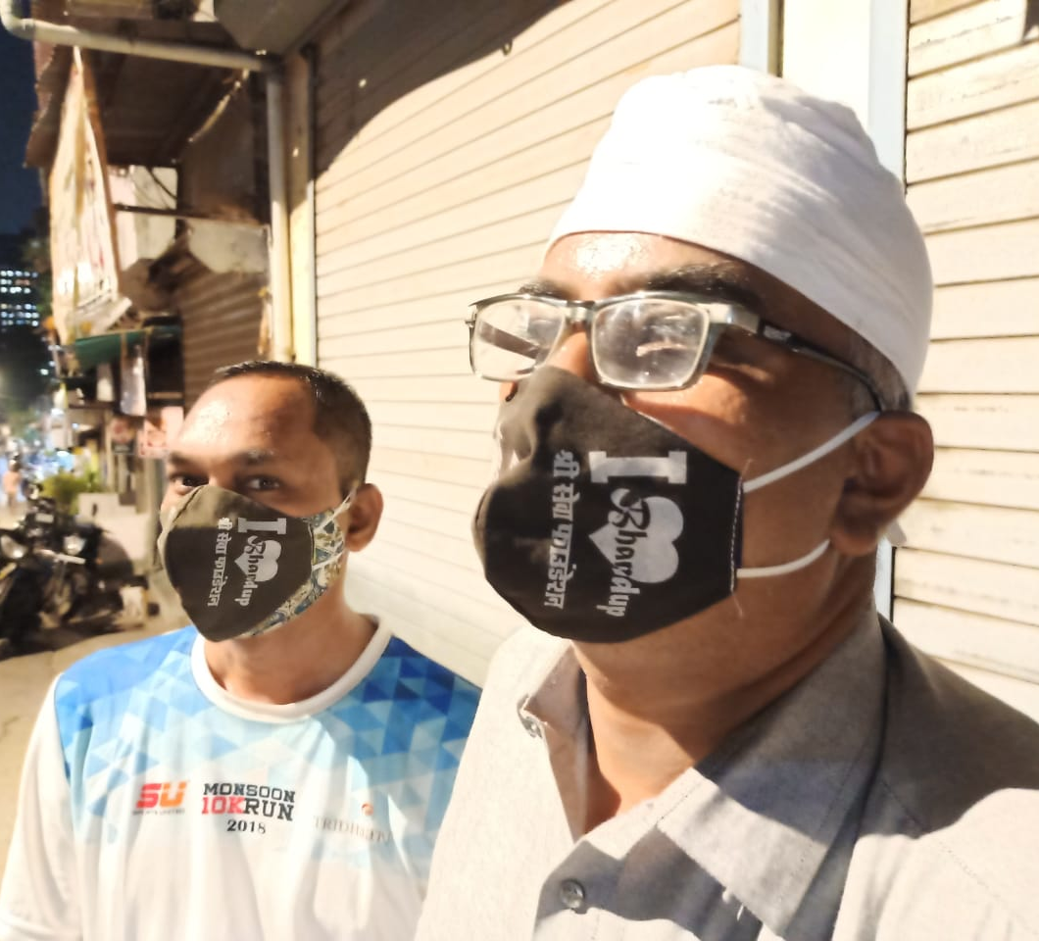
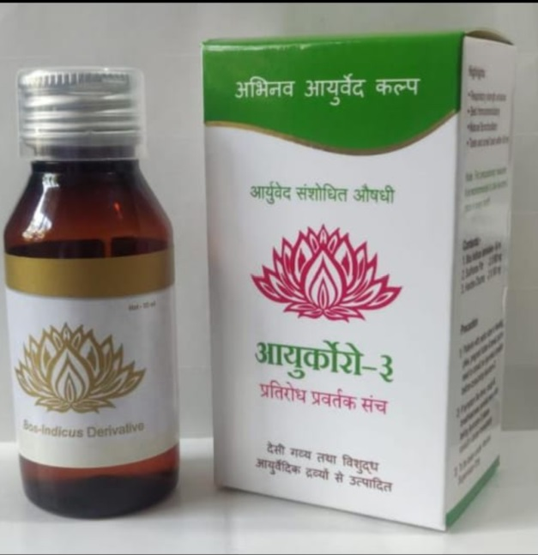
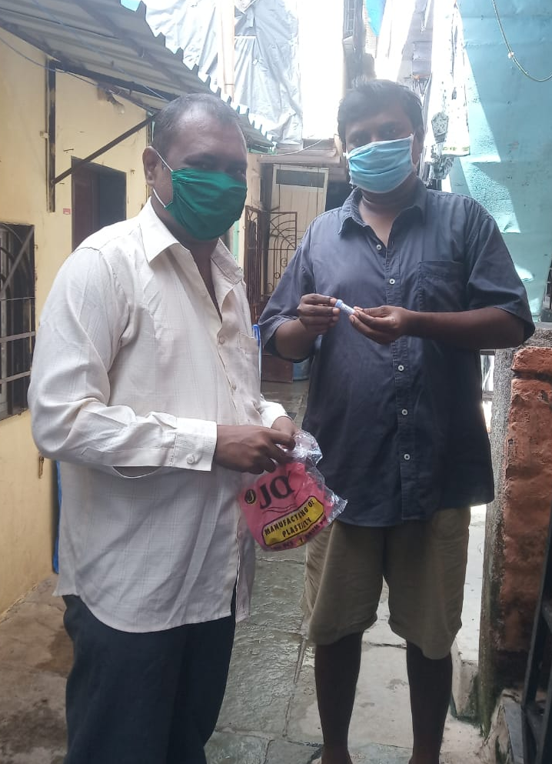
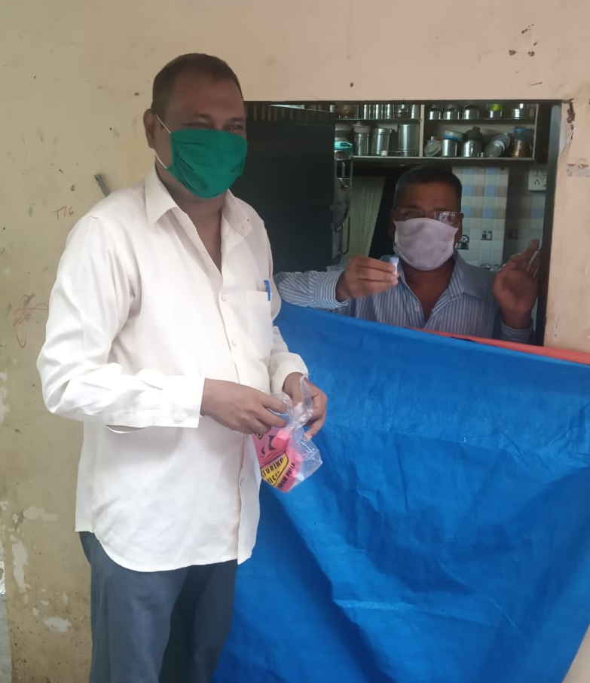
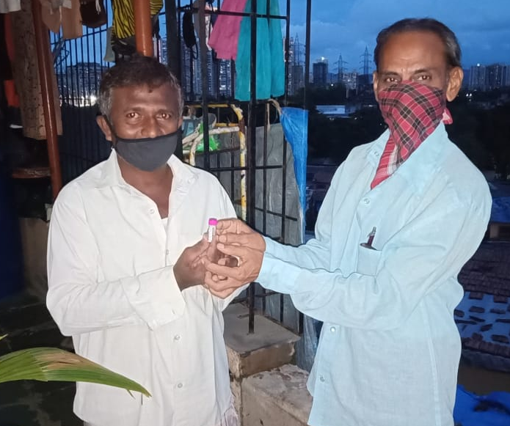
COVID-19
Face Mask
And Medicines
Distribution

Slide 25

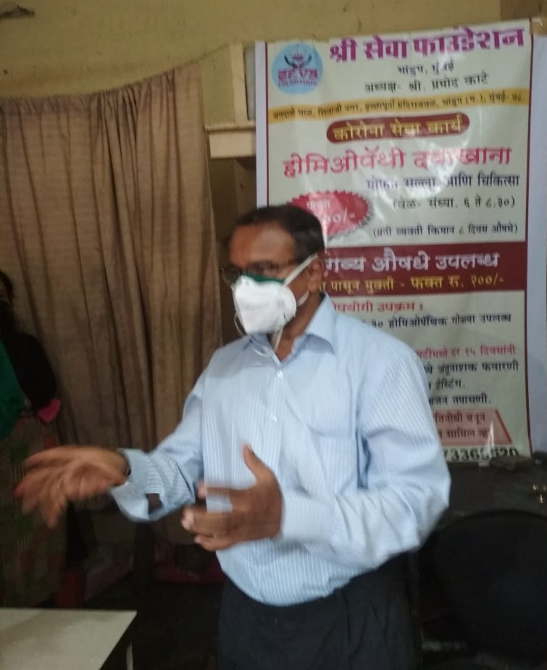
Opening of Homeopathic Dispensary
in Bhandup & Thane

Slide 26
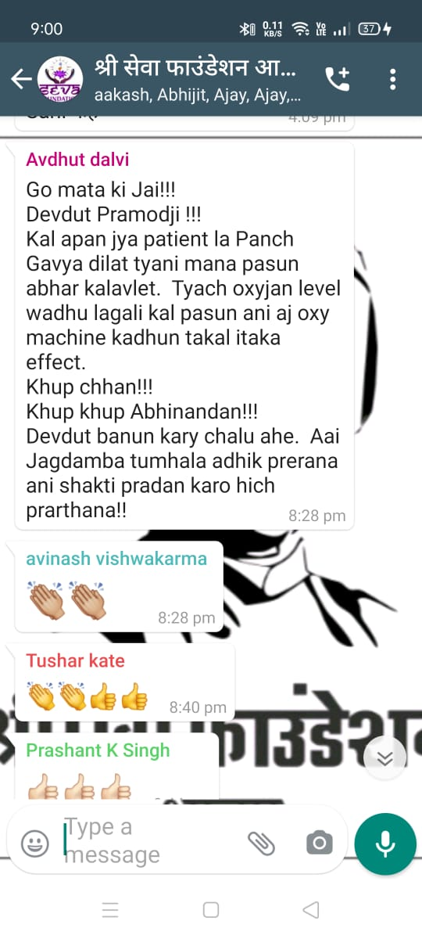
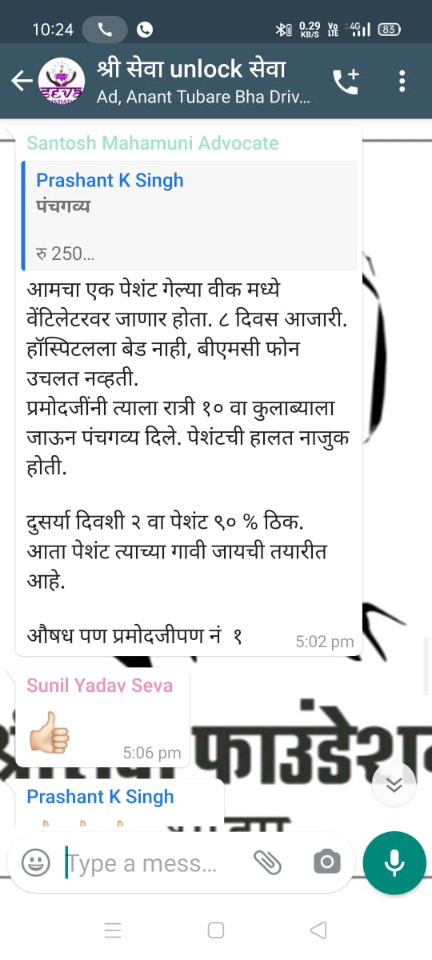
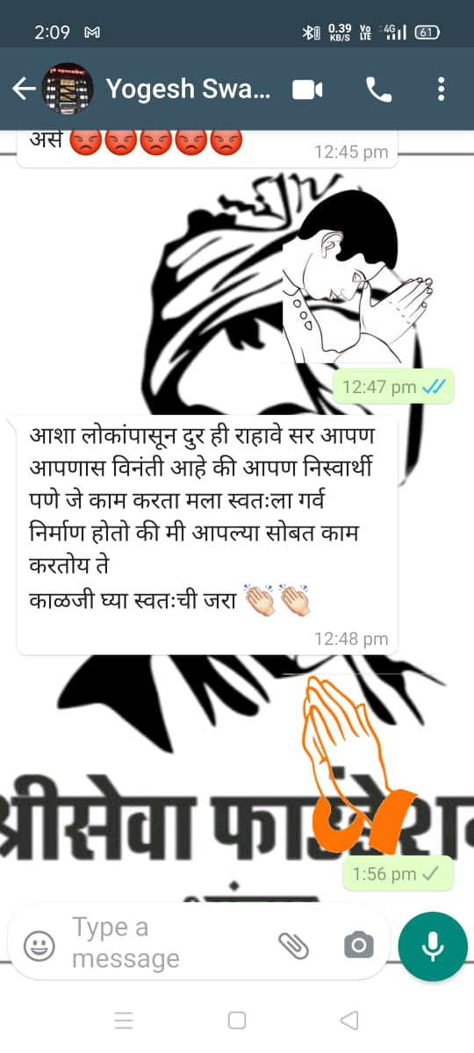
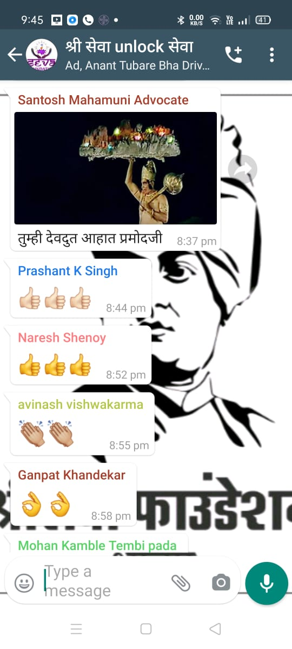

Responds from Public

Slide 27

Thanks letter from
Cama & Albess Hospital

Slide 28



FREE Medical Health
Check-up Bhandup, Mumbai.

Slide 29




Health Check-up Camp at Redlight Area, Mumbai.

Slide 30


Independce Day
Flag Hosting Ceremony

Slide 31

Shree Seva Foundation Awards Announcement
In January 2023 “Shree Seva Foundation”
announce felicitate some unknown personality.
Doctors
Nurse
Diagnostic Centre,
Govt. Officials,
NGO’s,
Social Workers
who serves public as social service during Lock-down pandemic time. The Event held at Ravindra Natyamandir, Mumbai.

Slide 32


Slide 33

Shree Seva Foundation
To support “Shree Seva Foundation” Contact : Mr. Pramod D. Kate
Mob. : 7977389380
Mail : contact@shreeseva.in
Pramod.kate1@gmail.com
Website : www.shreeseva.in

